Slide 1

Welcome SacPAS Workshop
December 6, 2023
Sacramento CA & Online

Slide 2
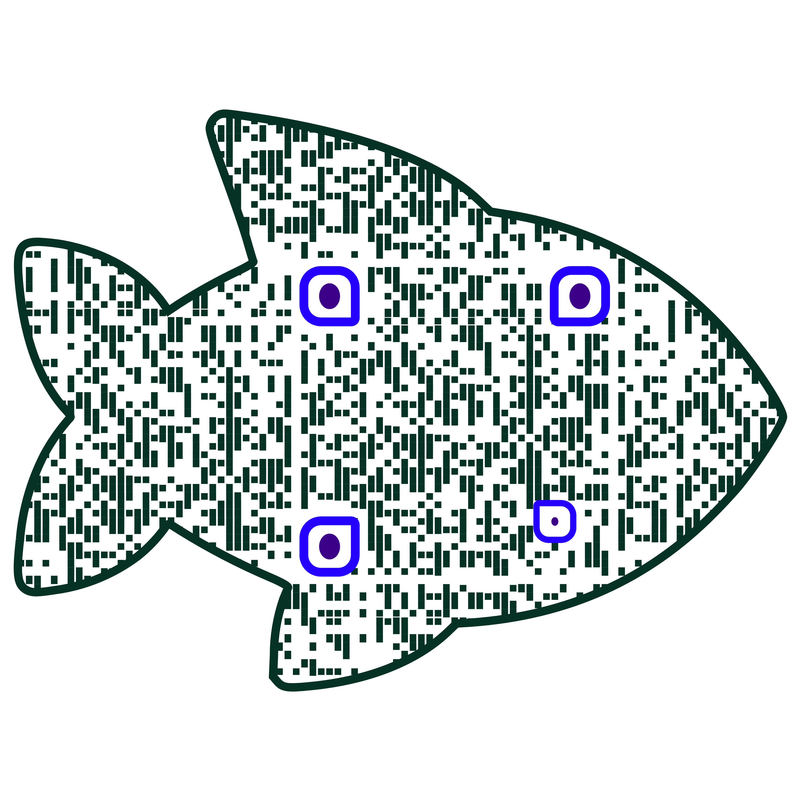
Schedule of SacPAS workshop Progression of thoughts and ideas throughout the day
9:40 Overview of SacPAS
UW CBR philosophy & approach
SacPAS Tools available
10:25 Open data & database management
Perspectives from SacPAS
Three handouts: FAQs, Guidelines, Pathways
10:50 BREAK
11:00 Open Discussion
Hear from workshop participants
Step through more specific examples
Generate new ideas
11:50 Recap & Closing remarks
12pm Lunch
1:30 Office Hours Options:
Continuation of specific examples
Breakout into small groups
Work groups / teams
Data management
Data visualization and query tools
Modeling tools
Workshop materials (Presentations, handouts, contact)
www.cbr.washington.edu/sacramento/SacPAS2023workshop/
(45 min)
(1.5 h)
(25 min)
(2 h)
(10 min)
(50 min)
(10 min)
Notes:
Thank you everyone for coming, my name is Cat Pien, I am a fish biologist in the Science Division at the Bureau of Reclamation, and I manage the SacPAS agreement with the University of Washington.
A couple logistics
For those of you here, help yourself to snacks and coffee.
The bathroom is right outside.
The wifi info is on the board, though please limit your use so that we can ensure smooth connection to our remote participants.
Since the meeting is hybrid, please use the microphones when speaking and state your name.
With that, here is the planned schedule for today (read off)

Slide 3


















Who is at the workshop?
34 affiliations
Federal agencies
State agencies
Water and irrigation districts
Consultants
Universities
Utilities
Notes:
Thank you all for answering the questions in the registration. This helped the team understand who is interested in using SacPAS, what tools are useful, and what can further be developed.
So you all have an idea of who is here, I wanted to share some of the survey results.
We have 34 affiliations represented, incl. federal agencies, state agencies, water districts, consultants, universities, and utilities
To keep this workshop collaborative, can those online please put your name and affiliation in the chat so we can all get a better idea of who is attending the workshop and who we are talking with?

Slide 4
Survey Results
Notes:
We have decent representation across different watersheds and teams, with a large number of you associated with IEP
In terms of familiarity with SacPas, the majority of people use SacPAS to some extent, but almost 40% of registrants have never used it, so hopefully this workshop will be a good introduction, and we can get some fresh perspectives

Slide 5
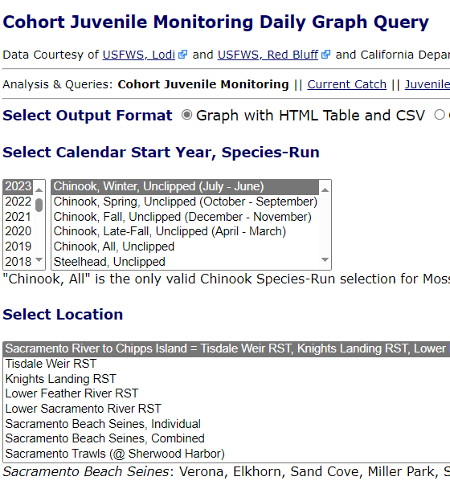
Which features are most useful?
Notes:
Fish queries appear to be the most frequently used feature based on the survey, though all of the listed features seemed to be used by a good number of respondents.
The team has been working on adding additional data sources and also additional species queries recently, so these queries will become increasingly useful
Thanks everyone, I’ll now pass it over to Jennifer Gosselin, the PI of SacPAS, who will talk about the goals of the workshop.

Slide 6
Hello Workshop Participants!
We are innovating!
SacPAS (UW Columbia Basin Research)
is an online resource for the region
as a collaboratorium embedded in PARTI principles
one of many online resources
secondary data repository & tools to close knowledge-action gaps
Purpose of the workshop: continue to grow this collaboratorium with you
Notes:
Thank you to USBR for the opportunity to hold this workshop and thank you to all of you, the workshop participants, for being here.
We are excited to have this workshop because we are together putting in the time today and effort to innovate on the process.
Yes, the SacPAS online tools are products themselves and these are important, but just as important is the process by which we co-create these tools and receive feedback from new users.
By default, as part of our process, we are innovating.
So what is SacPAS?
SacPAS, originally stood for Sacramento Prediction and Assessment of Salmon, but we've grown over the years, and is now more accurately named Central Valley Prediction and Assessment of Salmon and other fishes. Still, we're going to keep SacPAS for short.
It is an online resource to the region, a place where folks can access data, data visualizations, and model outputs.
It is in essence a collaboratorium – a term that I heard from Jim Anderson, who heard it from Josh Israel.
Collaboratorium, as you can see on the slide and hear say, it calls out to the word "collaborate" and there is root word -orium, meaning “a place of…”
And therefore, a place of collaboration. An online place of collaboration.
But SacPAS is not just a website, because websites can be easily created, but sometimes websites fail and they are not often visited.
So what makes a website useful and highly frequented? It is the people. The website needs to represent the people and the work being done.
Thus, the collaboriatorium is embedded in the principles of P-A-R-T-I (that you heard Elissa/Cat talk about already):
- participation
- accountability
- relevancy
- transparency
- innovation
Also, important to note, SacPAS is one of many online resources.
It has to be because it is essentially a secondary data repository.
The benefit of a secondary data repository is that it can be used to integrate various datasets and help create customized tools. Tools that can help close knowledge-actions gaps.
We look forward to continuing to grow this collaboratorium with you, with your input on what is relevant in terms of data and tools to help you conduct your work.

Slide 7
Strengths among all of us
SacPAS team
Workshop participants
Agencies/organizations
Work groups & teams
Stakeholders
…
The knowledge & potential among SacPAS team & workshop participants
Notes:
I would like to take a moment to acknowledge the strengths that exists among all of us - the SacPAS team and the diversity in workshop participants.
Altogether, we represent a lot of knowledge and potential - when we imagine cumulatively the hundreds of years of experience that exists among all of us - and all of the insight and epiphanies you likely have all had from time to time.

Slide 8
Workshop Objectives
Awareness of SacPAS tools
Streamline data management processes
Refine tools
Requests for new tools
Notes:
To help get us all on the same page and move forward today, the objectives for this workshop are:
1. For the SacPAS team to increase awarenesss of SacPAS tools
2. To learn and discuss some ways we can better streamline data management processes associated with SacPAS
3. to hear from you on how we can refine existing SacPAS tools, as well as
4. new tools you'd like to see.

Slide 9
What kinds of tools?
Tools that help with:
Planning
Real-time monitoring
Tracking performance
* Some exist to an extent, some in progress, some need refinement, some don’t exist (yet)
Notes:
Online Tools on SacPAS could be any that help you with your work on planning, real-time monitoring and tracking performance.
Some of these tools exist already to some extent, some are in progress, some need refinement, and some don't exist yet - but we can work together on them.
And with that, I will pass it back to Cat.

Slide 10
Questions?

