Slide 1


Open Data & Data Management - - - Perspectives from SacPAS
Jennifer L. Gosselin and Matt Carter
Notes:
Matt Carter and I are presenting on some perspectives from SacPAS on open data and database management.
Matt is the Database manager at CBR.

Slide 2
Open data & data management Perspectives from SacPAS
Overall Goal:
Make your work easier by providing efficient access to data
Support Interagency Ecological Program and AB1755
FAIR and CARE
Brief description & in context of SacPAS
What this looks like in practice at SacPAS
Examples
Three handouts
FAQs, Guidelines, Pathways
* Help us streamline data management processes for SacPAS so that we can help with that first bullet point on overall goal
Notes:
The overall goal, related to open data and database management at SacPAS, is for us to help make your work easier by providing efficient access to data. And thus support in indirect ways, the Interagency Ecological Program and AB1755 (the Open and Transparent Water Data Act).
[CLICK] In the spirit of open data and its benefits, we’ll briefly describe FAIR and CARE principles and what some of these principles mean to us at SacPAS.
[CLICK] Matt will then talk about what database management looks like in practice at SacPAS and share many examples.
[CLICK] We also have three handouts that we will mention at particular points during our presentation.
[CLICK] We would like to emphasize that we appreciate any help and insight on how we can better streamline data management processes because that way [CLICK] we can better address our over goal of helping you access data.

Slide 3
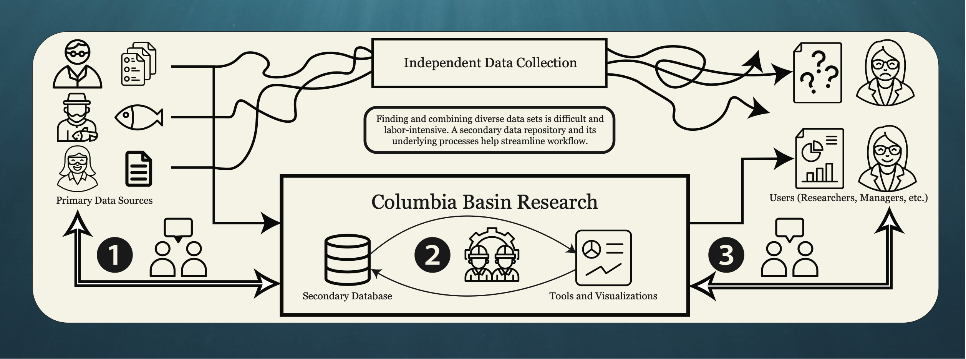
Motivation for Delivering Data & Tools Online
Notes:
This cartoon shows how data users trying to find and collate data sets from primary sources can be time-consuming and labor-intensive and therefore likely frustrating.

Slide 4
Motivation for Delivering Data & Tools Online
Notes:
A secondary data repository and its underlying processes can help streamline workflow.

Slide 5
Motivation for Delivering Data & Tools Online
Notes:
Here at CBR, we work with primary data sources and data owners to understand the data, sometimes help with QA/QC, and load the data to our servers. We create tools and visualizations using data from this secondary database of integrated data and help provide these products to users. That way, users can concentrate their time on other tasks and their main responsibilities.
In these three phases related to: 1) data acquisition & QAQC, 2) interoperability across different systems, and 3) creation of online products for users, I’ll step through in a little more detail about how these cycle.

Slide 6
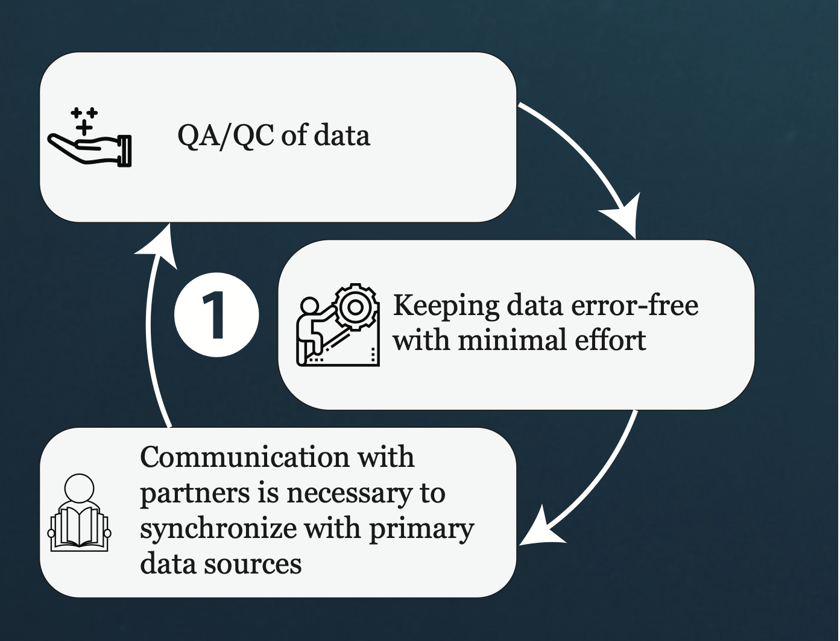
Collaboration & Co-creation
Notes:
With QAQC of the data, we aim to keep the data error-free with minimal effort. That requires communication with partners to synchronize with the primary data sources. And this is an ongoing process.

Slide 7
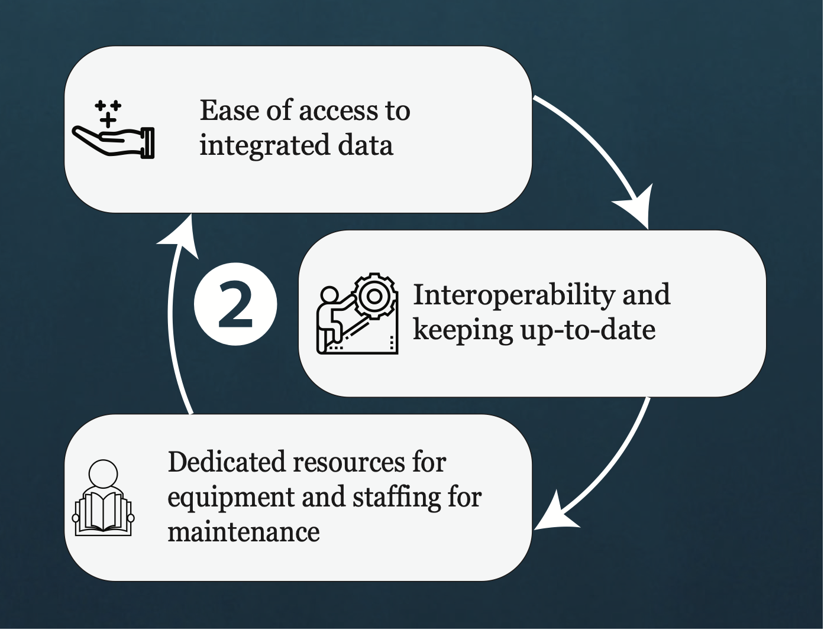
Collaboration & Co-creation
Notes:
To provide ease of access to integrated data, this requires interoperability between our systems with external systems, but also with all of our systems internally. We have dedicated resources in terms of equipment and staffing for continued maintenance. Thus this too is a cycle as new data come in and as systems get updated.

Slide 8
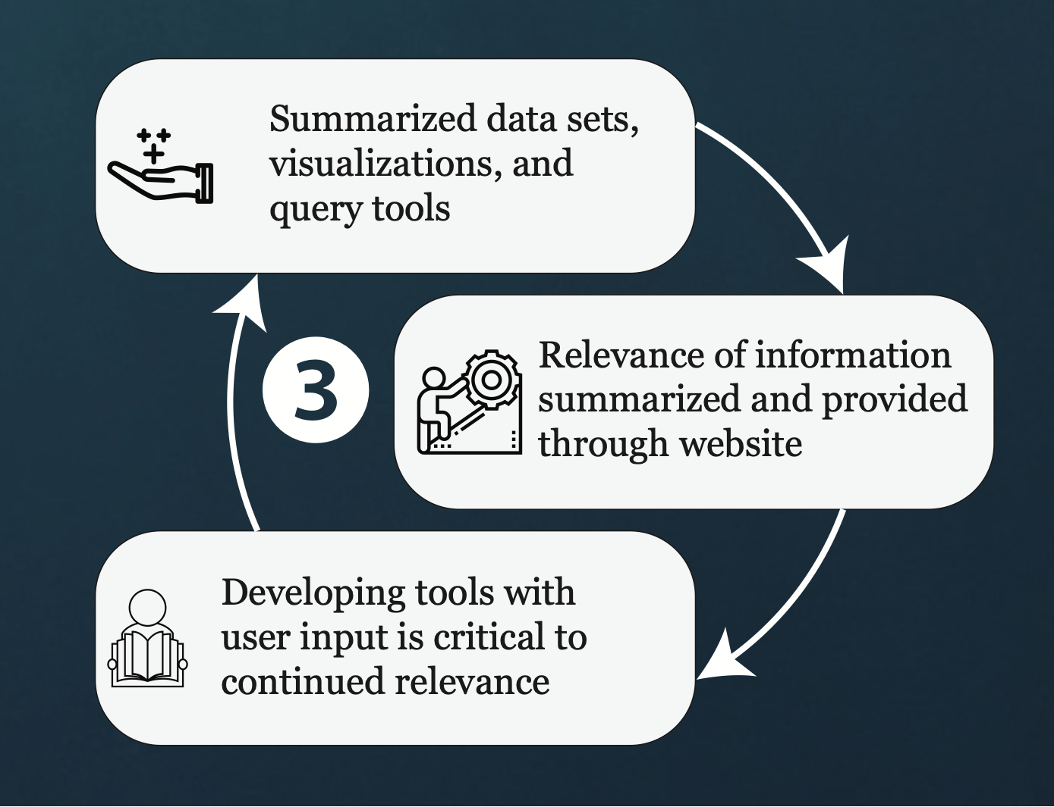
Collaboration & Co-creation
Notes:
Lastly, to provide products of summarized data sets, visualizations query tools, something we think about a lot is ensuring that the information we provide on the SacPAS website is relevant. Developing tools with user input is critical for continued relevance.

Slide 9
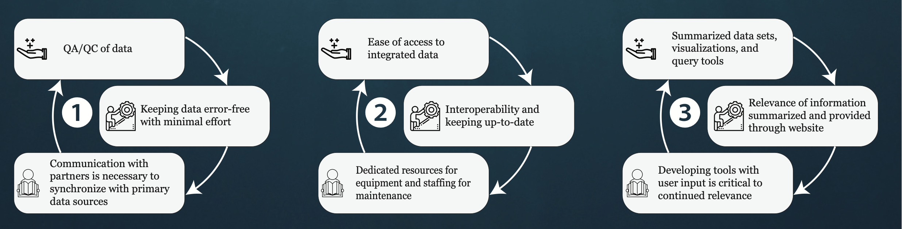
Collaboration & Co-creation
Notes:
Thus, collaboration and co-creation is key and an integral part of processes related to the data, interoperability and online products.

Slide 10
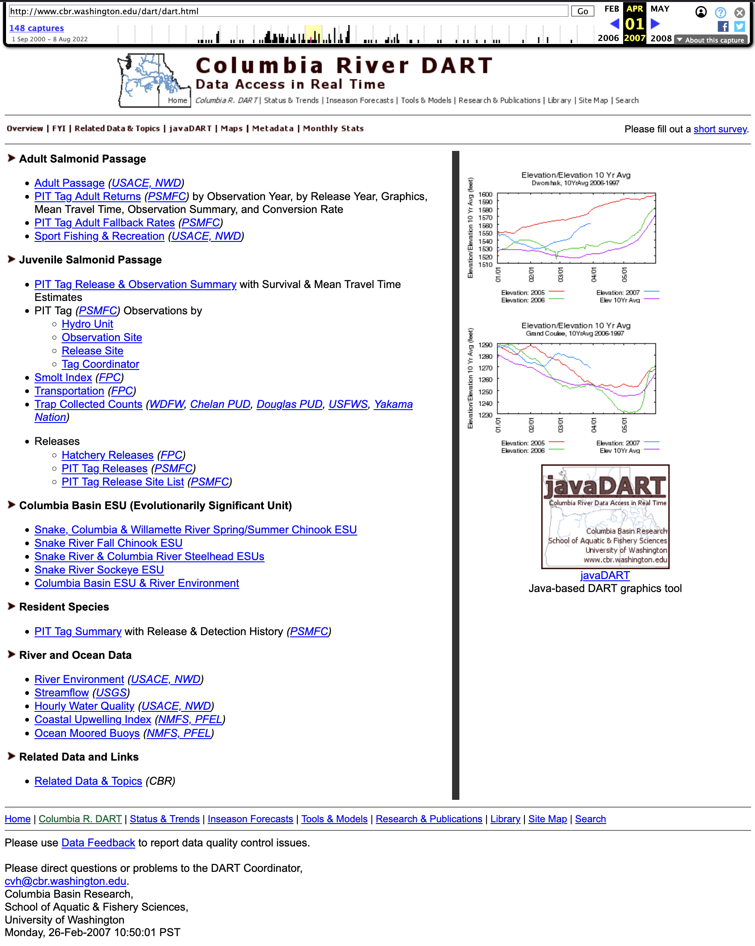

SacPAS
More info: SacPAS Database Management (DBM) FAQs (handout #3)
Secondary data repository of integrated and aggregated data
Open data mission since early 1990s with Columbia River DART
Continually developing principles of open data and database management:
FAIR principles
CARE principles
https://www.gida-global.org/care
Notes:
As I have mentioned before SacPAS is a secondary data repository of integrated and aggregated data. We at CBR have had an open data mission since the early 1990s starting with DART. Here is a screenshot of the DART website decades ago.
For more information about the SacPAS Database management, you can refer to handout #1 which lists FAQs with brief responses.
As we continue to develop and adapt our processes related to open data and database management, we draw from the FAIR and CARE principles.

Slide 11
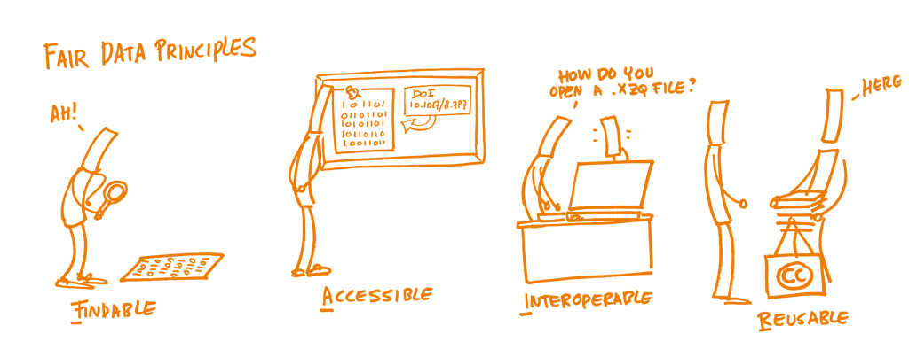
FAIR principles
https://www.researchgate.net/figure/A-cartoon-describing-FAIR-data-sharing4_fig1_355931017
Notes:
There many valuable data sets that exist, and SacPAS assists in making these findable and accessible.
As we encounter issues of interoperability, we sympathize with these struggles and continue to work towards make the data sets and products we offer through SacPAS workable for you.
In terms of data reusability, the vast majority of data we have at CBR, and all of the data on SacPAS are data that we are reusing. We are not the primary data owners.
https://www.researchgate.net/figure/A-cartoon-describing-FAIR-data-sharing4_fig1_355931017

Slide 12
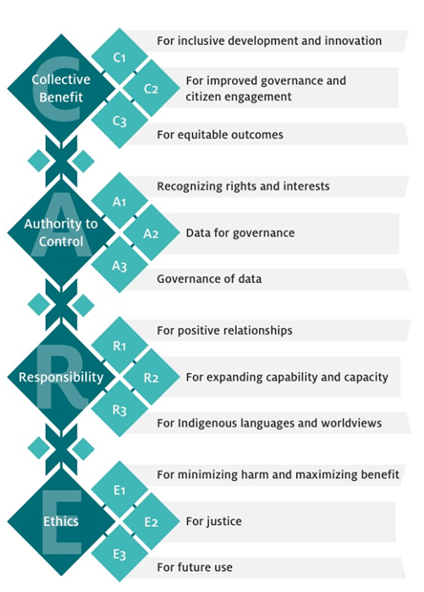
CARE principles
“Start where you are to go where you need to go.”
- Margaret Kovach
https://www.gida-global.org/care
Notes:
In terms of CARE principles.
Collective Benefit
Authority to Control
Responsibility
and Ethics.
Therefore, you could think about FAIR principles as the technical side of things and the CARE principles as the people side of things.
We, the SacPAS team, think a lot about our users, and where we excel the most here is A for authority to control. We respect the data owners and do our best to represent things accurately. We are a small team, but we always try our best here.
We are also deepening our understanding of indigenous data sovereignty. As much as we would like to be further along in our understanding, we realize that to keep moving forward we need to [CLICK] start where we are, to go where you need to go.”
We could have a whole week conference on FAIR and CARE principles, but there are a lot of resources out there, and so I will…

Slide 13
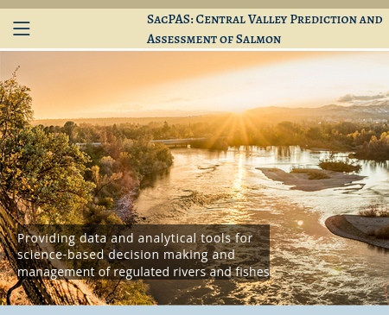
What open data looks like in practice with SacPAS
Notes:
Continue on with sharing what open data looks like in practice with SacPAS.

Slide 14
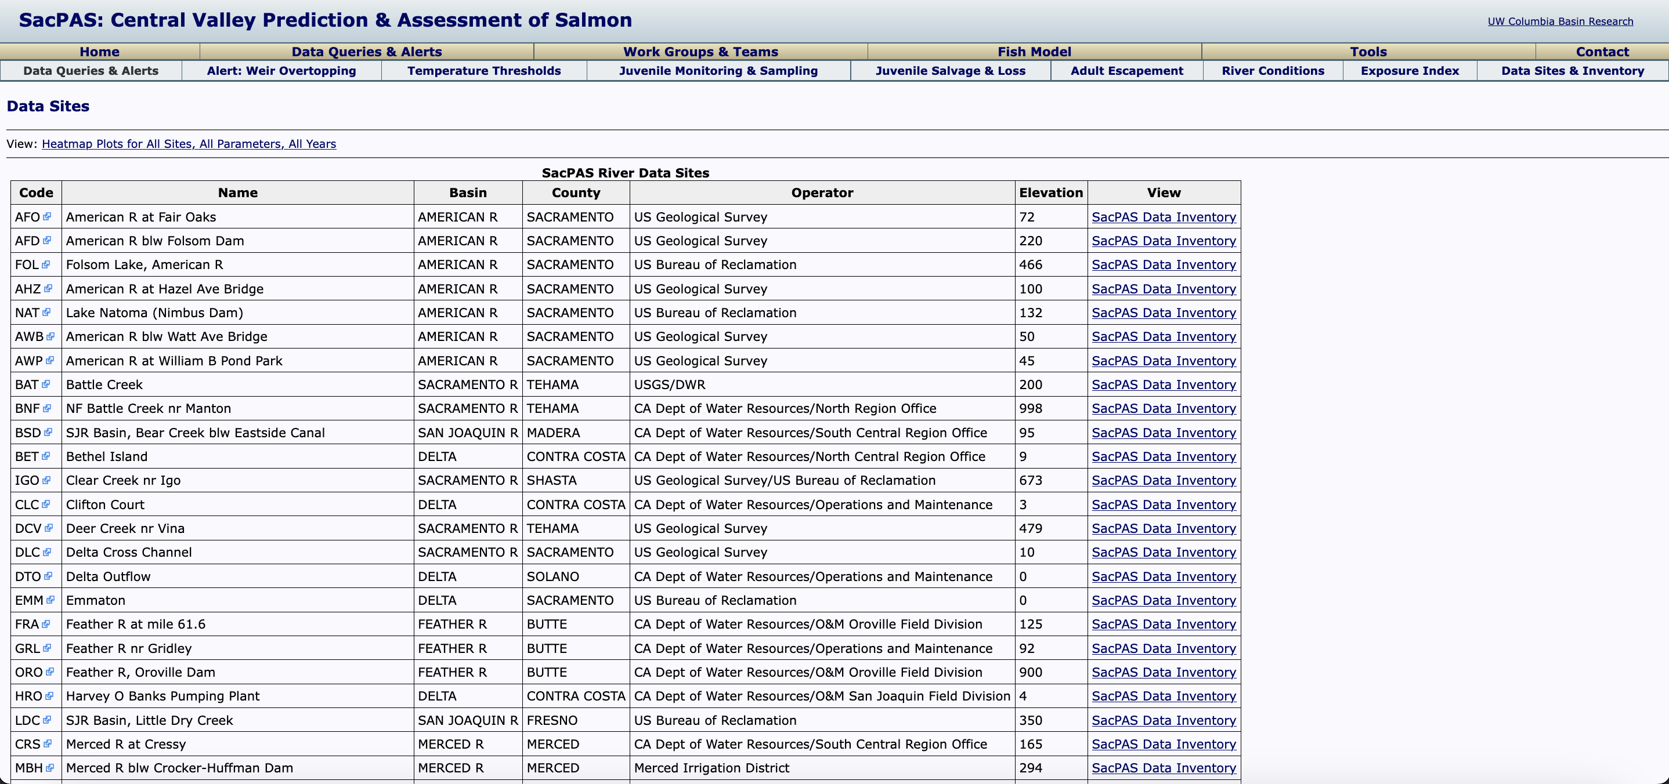
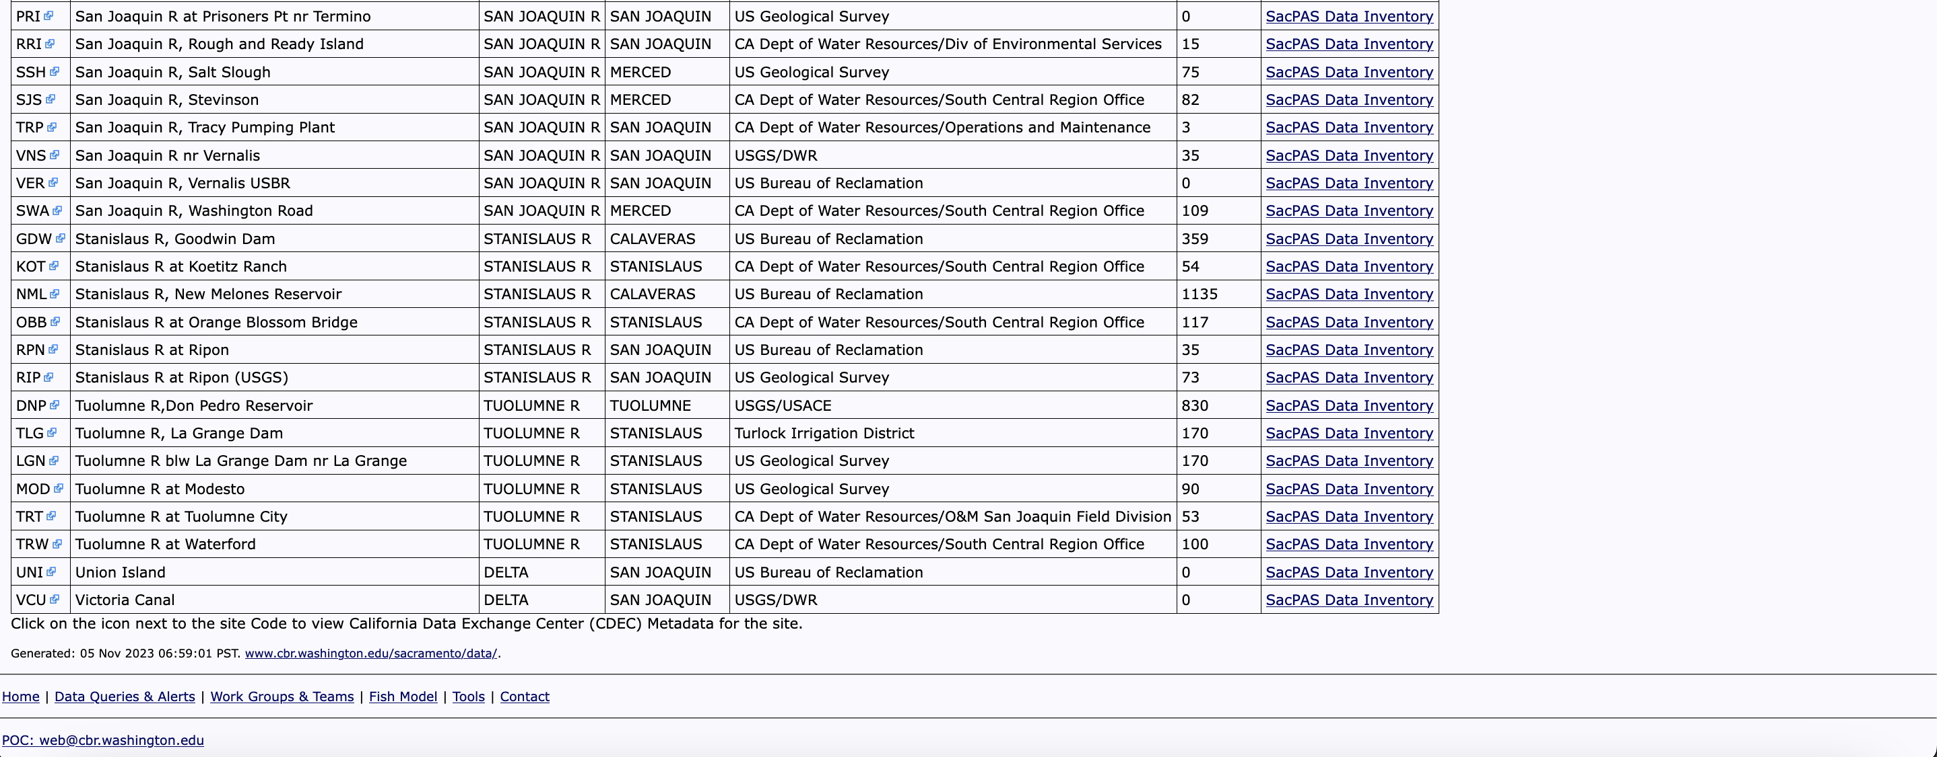
.
.
.
Notes:
As you saw in the Overview of SacPAS presentation, there are a lot of data available in table format and that are downloadable.

Slide 15

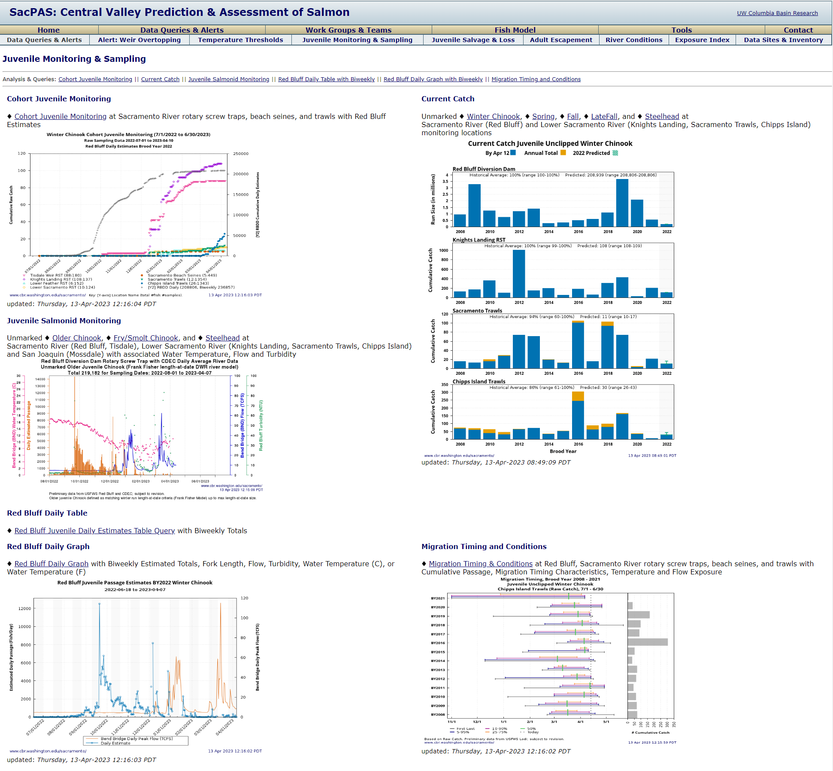
Juvenile Monitoring & Sampling
https://www.cbr.washington.edu/sacramento/data/juv_monitoring.html
Notes:
Many of the data sets have statistical summaries and metrics shown with data visualizations.

Slide 16
Snapshot of data available on SacPAS
Fish data (Salmon, smelt)
Cohort Juvenile Monitoring (CDFW via CalFish, USFWS Lodi, USFWS Red Bluff) Counts and migration timing; RSTs, trawls, beach seines
Red Bluff Diversion Dam biweekly (USFWS Red Bluff) Counts, migration timing, length-at-date (LAD)
Salvage and Loss (CDFW Bay Delta Region) Counts, migration timing, LAD, genetic run ID, CWT run
Adult escapement (GrandTab, CDFW via CalFish)
Coded wire tag (RMPC/RMIS, PSMFC) Smolt-to-adult survival
Redd and carcass survey (CDFW via CalFish)
Juvenile Production Estimate (JPE) (NOAA)
Delta Smelt (USFWS Lodi, CDFW; not CalFish) Current and historical surveys
Etc.
Environmental data (courtesy of CDEC)
Reservoir storage
Reservoir elevation
Reservoir outflow
River discharge
River stage
Control regulating discharge
Water temperature
Water velocity
Dissolved oxygen
Weir overtopping (stage, SacPAS metric)
Air temperature
Etc.
Notes:
Here is a snapshot of data accessible through SacPAS. We covered quite a few examples over many slides, and in case it is useful to see in one slide, here relatively high level snapshot. To name a few, for environmental data, these include… and for fish data, these include…
Again, our presentations will be available online for download if you wish to revisit this slide.

Slide 17
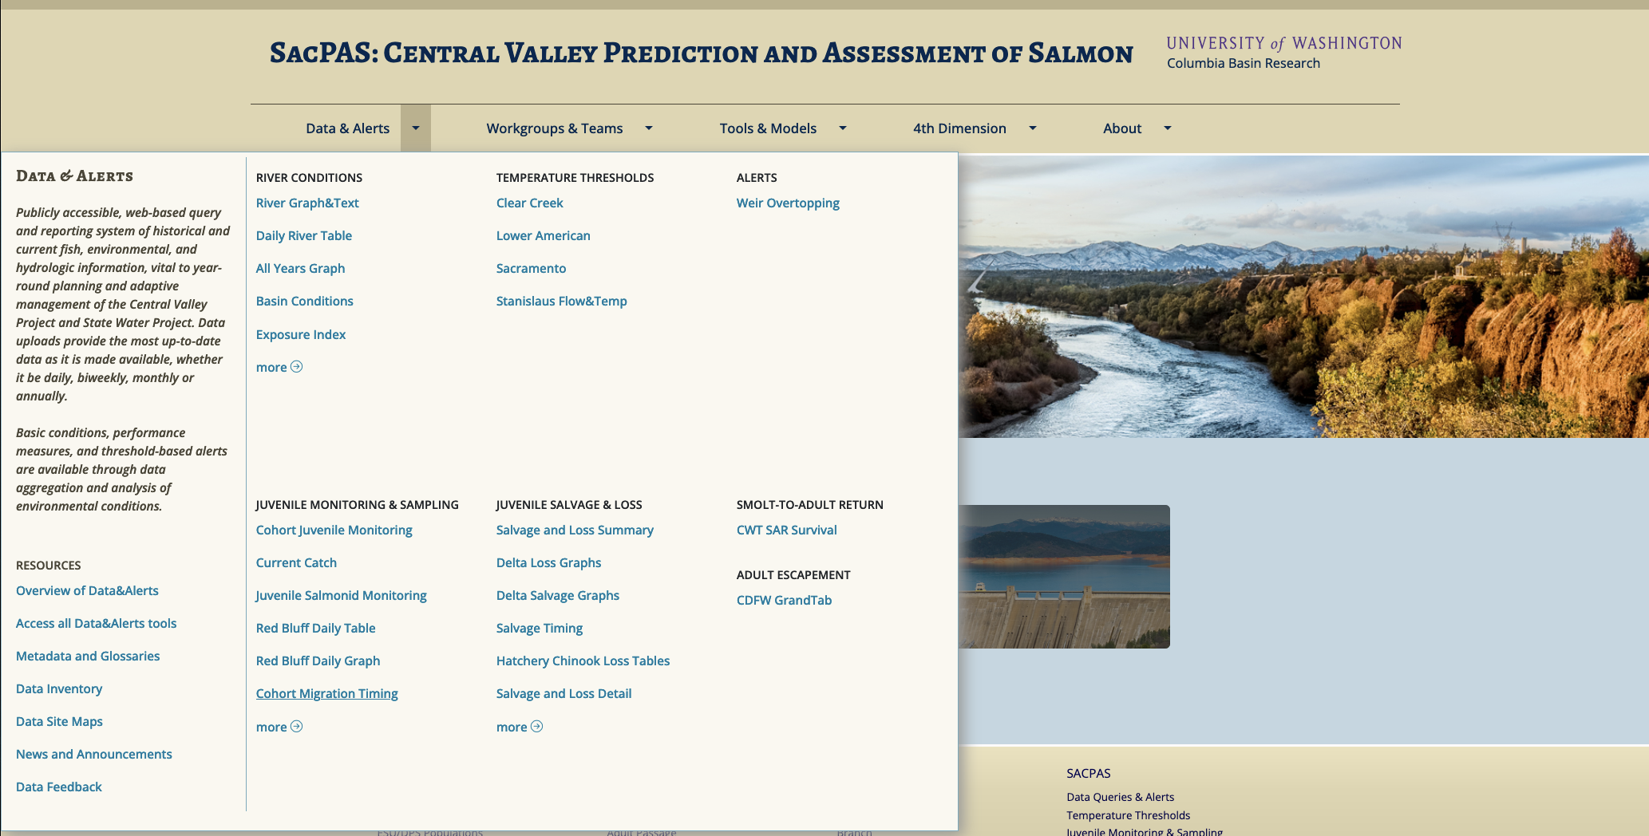
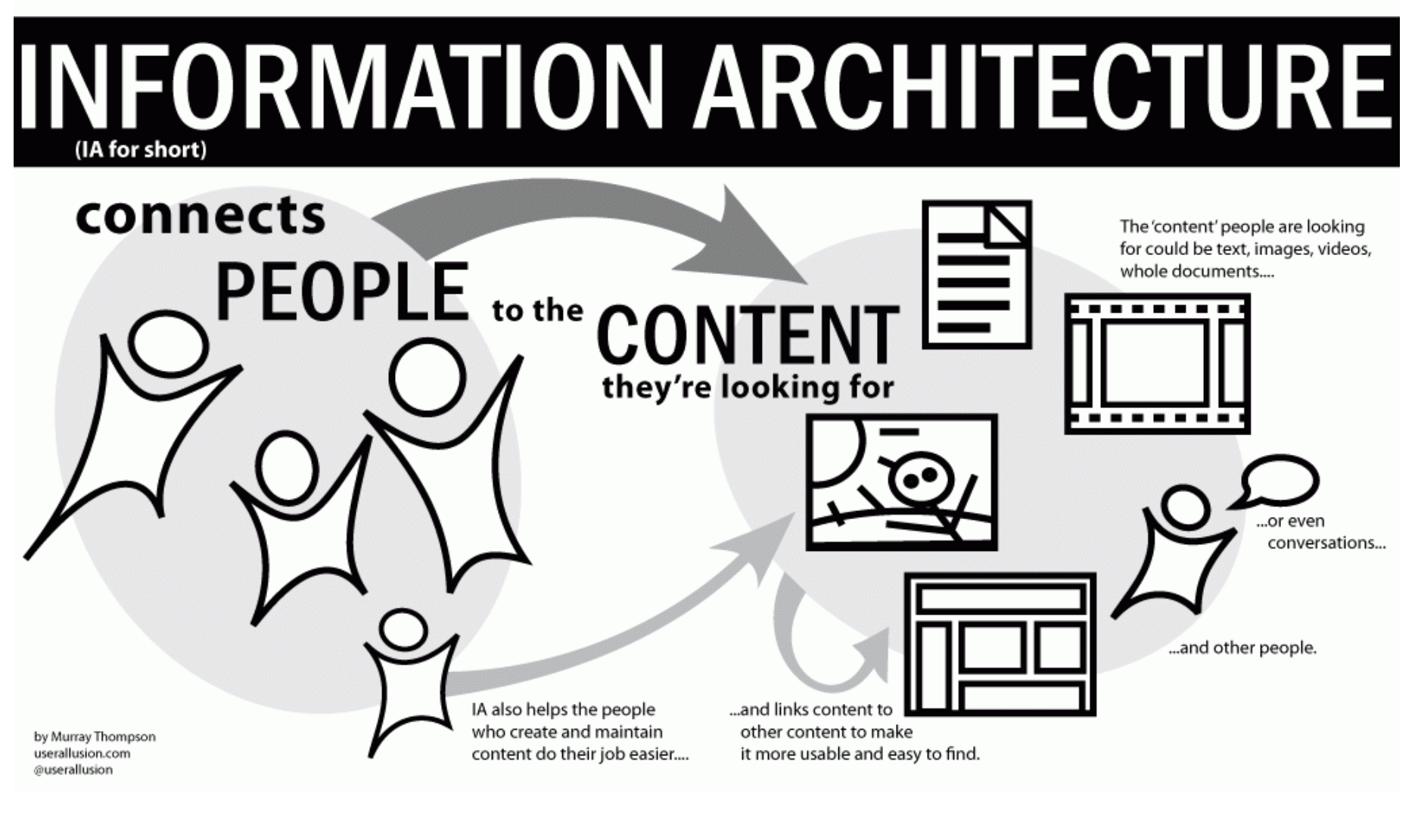
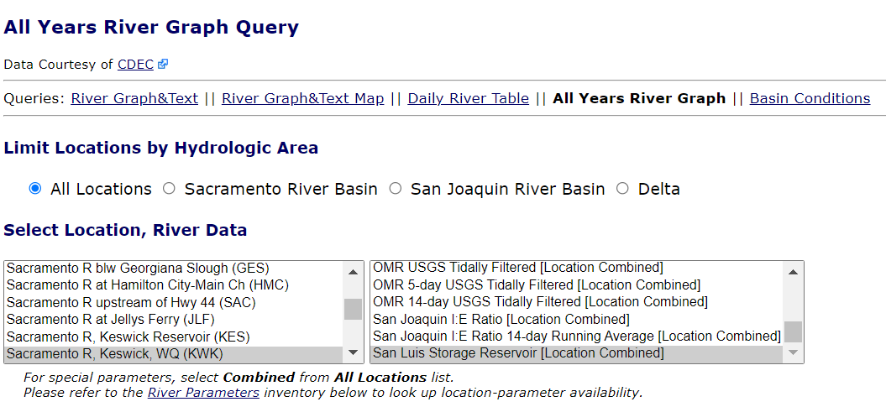
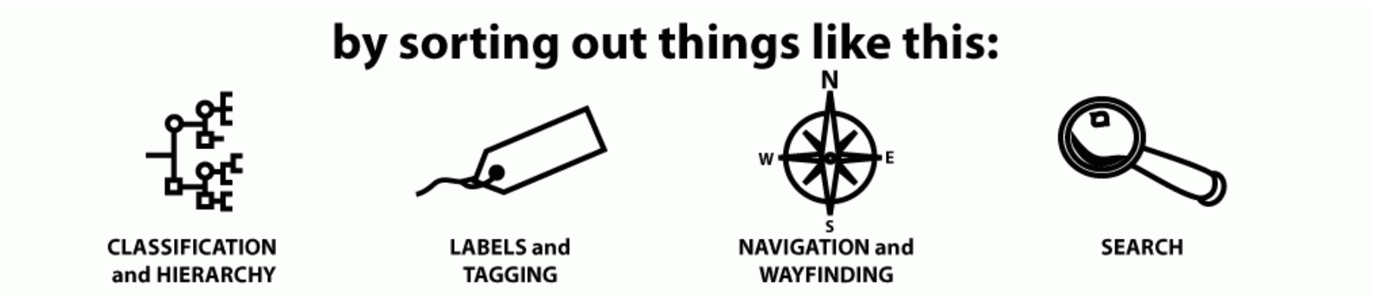
MegaMenu
Customized query forms
Notes:
With the growing number of data sets and tools accumulating on SacPAS, we are intentionally thinking about information architecture to help connect users to the content that’s on SacPAS as intuitively and efficiently as possible.
We have the MegaMenu for the reorganization of content for our upcoming new website.
We also have customized query forms for you to access pertinent information.

Slide 18
What database management looks like in practice with SacPAS
Notes:
Briefly introduce myself
Provide view into database management with SacPas (click)

Slide 19
Examples
Sharing some perspectives from SacPAS with examples that we’ve experienced
Notes:
Examples of guidelines to help increase data sharing efficiency
Learned from experience
We can code everything and handle everything, but it introduces error and takes time
Recommendations not requirements
(click)

Slide 20
How To Increase Efficiency Of Sharing Data
EXAMPLES:
Data location is findable and accessible.
File format is simple and consistent.
Keeping fixed location online, ftp, sftp
Keeping file format consistent (.csv to .xlsx)
Avoiding .pdf files
Checking that your cells format correctly when converted to .csv
Guidelines on Data Sharing (see SacPAS DBM handout #4)
Notes:
First guideline to increasing efficiency
Data location is findable and accessible and file format is simple and consistent
(click)
Examples include:
Having data on fixed location online, a ftp site, or sftp for more security
As opposed to inconsistent location or via personal communication
Keep file format consistent
.csv and .xlsx both work but are coded differently and we have had times where data doesn’t load because it has changed to a .csv or .xlsx
Avoid pdf for data sharing, good for reports but should provide data separately
Check data when exported to csv
We have seen dates or times converted by excel to integers and then we had to bring it to excel and then convert it back
Can’t convert back as csv
(Click)

Slide 21
How To Increase Efficiency Of Sharing Data
EXAMPLES:
Keep data files simple for programmable loads.
Avoiding gaps in between columns in a spreadsheet for aesthetics
Limiting to one table per worksheet
Including ID column and keep rows unique
Guidelines on Data Sharing (see SacPAS DBM handout #4)
Notes:
Next Guideline
Keep data files simple for programmable loads
(click)
Examples include:
Avoid gaps between columns
Many spreadsheets designed for aesthetics but the more complicated the formatting the harder it is to load
For data sharing efficiency, simple csv’s work the best, remember datasheets need to be read by both people and computers
However, we understand that if the vast majority of the audience is viewing the files rather than a machine, then we can handle these types of files
We simply hope that it is part of your consideration
In the same manner, if possible, limit to 1 table per worksheet
Different tables with different formats need to be separated before loading which is harder to do programmatically
An alternative is to separate tables into different worksheets in a workbook
Try to include ID columns and keep rows unique
We have seen duplicate columns
Unclear if a mistake or actual second measure for certain datasets
We reached out to the data provider and it turned out that it was an intentional duplicate
That’s why it is good to have ID columns if duplicates are possible
(click)

Slide 22
How To Increase Efficiency Of Sharing Data
Data is machine readable.
EXAMPLES:
Not including double quotes “” in comments column
Avoiding line breaks and commas in the comments column
Guidelines on Data Sharing (see SacPAS DBM handout #4)
Notes:
Also try to keep data machine readable (click)
Don’t include double quotes in comments column
this can confuse the methods we use
Also avoid line breaks, commas, and semicolons in comments columns
Not as important but we need to include code to address these
(click)

Slide 23
How To Increase Efficiency Of Sharing Data
EXAMPLES:
Checking for Spelling or human error in data entry
Keeping data type consistent
Choosing one null (N/A, na, NN, NA, NULL, n/p, -9999, -99999, UNK, n:/a, N/R)
Including all data as they accumulate through the season (or year) in the data file
Keeping format of revised data similar to preliminary data
Data is consistent.
Guidelines on Data Sharing (see SacPAS DBM handout #4)
Notes:
Finally keep Data consistent
(click)
Examples include:
Check for Spelling errors and or human error in data entry
Seen dates and times that don’t make sense
Seen different spellings of regions or sites
We can correct these but not if the error is in a value since we don’t know what the value should be
Keep data type consistent, if a column is integers, don’t put text in it
We have seen text saying the reason why a value wasn’t measured, which is good info but when we load values we have to choose a data type and so that requires human intervention
Choose one representation for null and stick with it
We have seen all of these and more
Before we have had values like temperature and flow switch places which we were luckily able to notice but it can cause bad data
Include all data as they accumulate over the season or year
Lets us update revised data as season continues and not just at end of year
We don’t want to include incorrect data on our website and maintaining old values lets us correct values without direct intervention
Also Keep format of end of year revised data similar to preliminary so we can replace data with revised
Otherwise hard to integrate revised data into mid year data tools
While these all seem like minor changes we work with over 40 data sets and if only one of these examples appear just twice a year then that is manual maintenance and intervention more than once a week
These recommendations and more are included on our Guidelines on Data Sharing handout
(click)

Slide 24
Data sharing: pathways across a range of efficiencies (see DBM handout #3)
To improve the efficiency and quality of shared data
Not always a straightforward one-size-fits-all process
We acknowledge some data require more caution and discretion when sharing openly
We are always happy to discuss how to best represent the wishes of the primary data owners (A in CARE principles)
Notes:
Our third handout is a resource to explore the range of data sharing efficiencies through the lens of the fair principles (click)
The goal is to improve the efficiency and quality of shared data
(click)
Not one size fits all
(click)
Some data requires more caution and discretion when sharing which can be balanced with the sharing efficiency
(click)
Always happy to discuss how to best represent the wishes of the primary data owners
(click)

Slide 25


(DBM handout #5)
Data are…
released in close to real time and later revised as data are corrected
released in close to real time with no revisions
published as a yearly revised dataset
published over a year after collection
the original collected data with corrections or omissions explained in a comments column
aggregated by the day in a more detailed spreadsheet
aggregated into a simple spreadsheet over an extended observation period
aggregated down to a single number without clear methods
Reusable
Data are the original collected data with corrections or omissions explained in a comments column
Data are aggregated by the day in a more detailed spreadsheet
Data are aggregated into a simple spreadsheet for an extended period of data
Data are aggregated down to a single number without clear methods
Data types are…
consistent, or cells are left blank with a comment in the comments column.
inconsistent, comments are placed in integer rows, dates and times are not represented consistently
Interoperable
Data…
are inconsistent with column names, number of columns, or order of columns
has consistent column headers in a consistent order
Data are…
published to website in a consistent location with a consistent naming scheme
shared through personal communication or consistently to a location that requires approved access
published to a website inconsistently or with inconsistent URL or filename
kept in house
Findable & Accessible
Efficient
Inefficient
Notes:
We will be looking at data sharing through the lens of the Fair principles
As an exercise, look at the handout and think about the processes you have in place
where can you become more efficient without sacrificing data security
(click)
In the realm of findable and accessible
The most efficient data sharing practices are when
Data are published to a publicly accessible website with a consistent location and naming scheme
Still findable but less accessible when data are shared through personal communication consistently or uploaded to a location with approved access like a sftp site
Less findable and accessible is when data are published but inconsistently, so it is difficult to locate from outside the organization
And the least efficient is when the data are kept in house
(click)
For interoperability, the categories are based on the machine readability of the data sets
More efficient when the data is easily readable by a machine
(click)
When thinking about reusability the data needs to be reproducible, the most efficient data sharing is when the data is as close to the form it was collected in and released in close to real time.
This category can be the most sensitive so balance the need for openness and efficiency with data security
These are just examples and there are many other facits of efficient data sharing
(click)

Slide 26
Open data & data management Perspectives from SacPAS
Overall Goal:
Make your work easier by providing efficient access to data
Support Interagency Ecological Program and AB1755
FAIR and CARE
Brief description & in context of SacPAS
What this looks like in practice at SacPAS
Examples
Three DBM handouts
FAQs, Guidelines, Pathways
* Help us streamline data management processes for SacPAS so that we can help with that first bullet point on overall goal
Notes:
To return to the goal of this presentation
The more streamlined the data are when released the more time we have to provide more tools to you, our users
We don’t say best practices on purpose because our perspective is only one side of the story
We want to work with you to find the practices and procedures that work best for you (click)

Slide 27
Acknowledgements
US Bureau of Reclamation
Catarina Pien, Elissa Buttermore, Josh Israel, and many more
All of the data collectors over the decades!
We hope to hear from you!
web@cbr.washington.edu
Hearing about errors, bugs, etc. makes us better.
Notes:
Email us if you would like to work with us or if you see any errors on our website or have anything new you would like to see
Thank you to the BOR and all of the people working to collect data over the decades.

