Slide 1


Online tools for the San Joaquin River Restoration Program
An example of the co-creation process for online tools on SacPAS
SacPAS team: Susannah Iltis & Jennifer Gosselin SJRRP: Chadwick Moore & Erika Kegel
SacPAS workshop Dec. 6, 2023

Slide 2
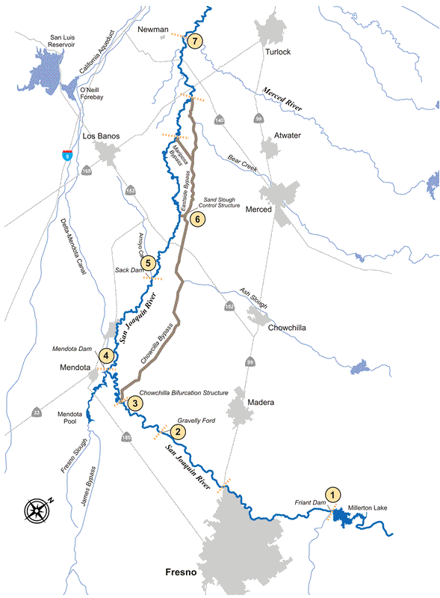
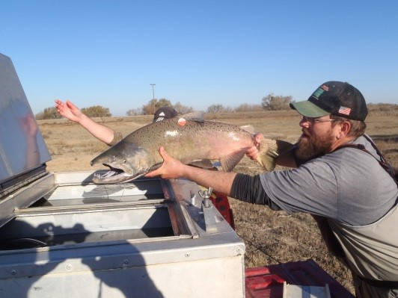
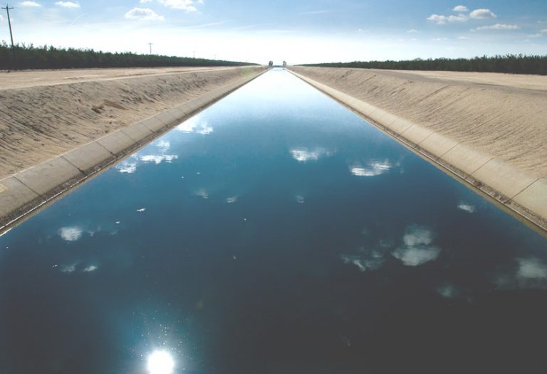
Background on SJRRP
San Joaquin River Restoration Settlement
The San Joaquin River Restoration Program is the direct result of the San Joaquin River Restoration Settlement reached in September 2006 by the U.S. Departments of the Interior and Commerce, the Natural Resources Defense Council (NRDC), and the Friant Water Users Authority (FWUA). The Settlement, which followed an 18-year lawsuit, received Federal court approval in October 2006.
Federal legislation, the San Joaquin River Restoration Settlement Act, was passed in March 2009 authorizing Federal agencies to implement the Settlement.
The San Joaquin River Restoration Program (SJRRP) is a comprehensive, long-term effort to release flows from Friant Dam to the confluence of Merced River, implement channel and structural improvements and restore a self-sustaining Chinook salmon population while reducing or avoiding adverse water supply impacts from Restoration Flows.
Two Settlement Goals
Restoration: To restore and maintain fish populations in “good condition” in the main stem of the San Joaquin River below Friant Dam to the confluence of the Merced River, including naturally reproducing and self-sustaining populations of salmon and other fish.
Water Management: To reduce or avoid adverse water supply impacts to all of the Friant Division long-term contractors that may result from the Interim Flows and Restoration Flows provided for in the Settlement.
https://www.restoresjr.net/

Slide 3
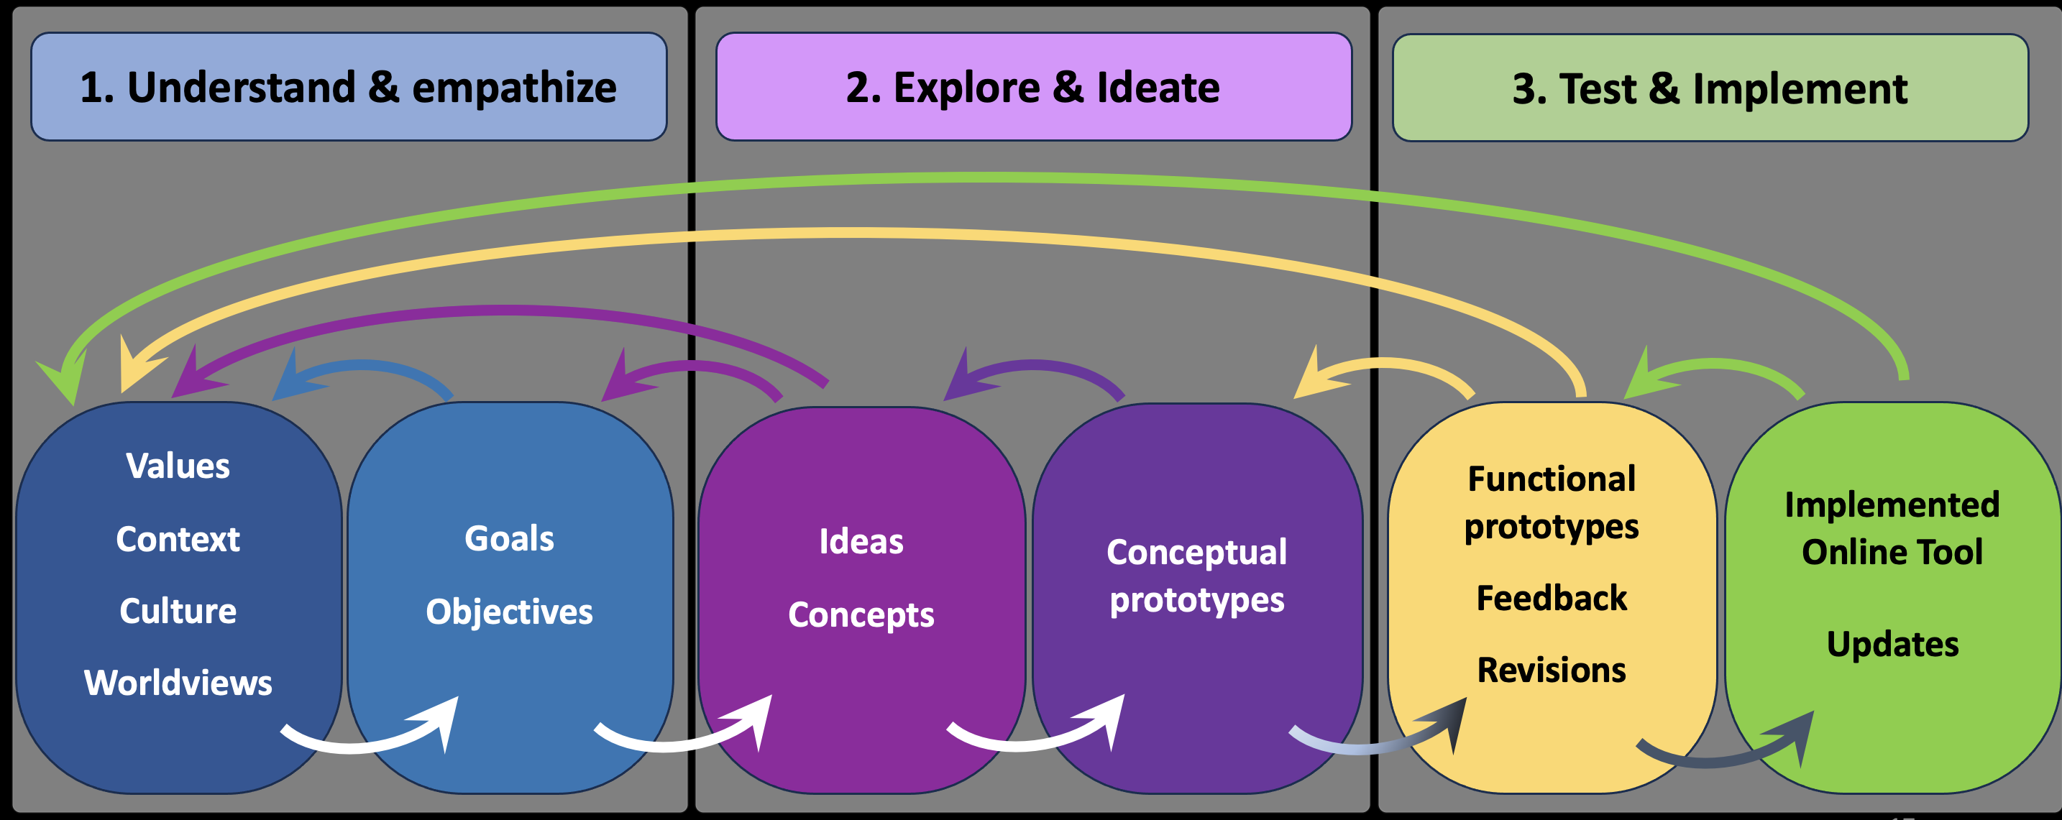
Design Thinking process of co-creating a SacPAS tool
Initial meeting:
SacPAS to hear: What’s needed
SJRRP to hear: What’s possible
SacPAS aims to meet needs of users
Data automation
Online tools
Schedule of development of tools
In this presentation, we’ll share the design thinking process thus far in tools for SJRRP…

Slide 4
Initial meeting with SacPAS
Met December 2022
Online Tools related to D-1641?
Data and how to access?
Data sheet via email
Data from pdfs
Static url
Can SacPAS handle the complex spreadsheets?

Slide 5
Follow-up meetings in July 2023 - present: Request for Two Team Pages
Team Page #1: River Restoration Flows
Identifies location and amount of environmental flows, Friant Dam – Delta
Restoration Year Flow Volumes (by month and year)
Restoration Year Flows (rates by day)
Volumes organized around Restoration Year (Mar-Feb); Flows organized around Water Year (Oct-Sep)
Data derived from SJRRP Operations spreadsheet
Team Page #2: Delta Water Quality (WQ)
Identifies D-1641 compliance and trends;
WQ objectives for:
Municipal & Industrial beneficial use
Agricultural beneficial use
Fish and Wildlife beneficial use
Salinity (X2)
Organized around Water Year and seasonal compliance
Data available on CDEC, CVO reports and DWR Delta operations summary
Currently focusing on co-creating Team Page #1

Slide 6
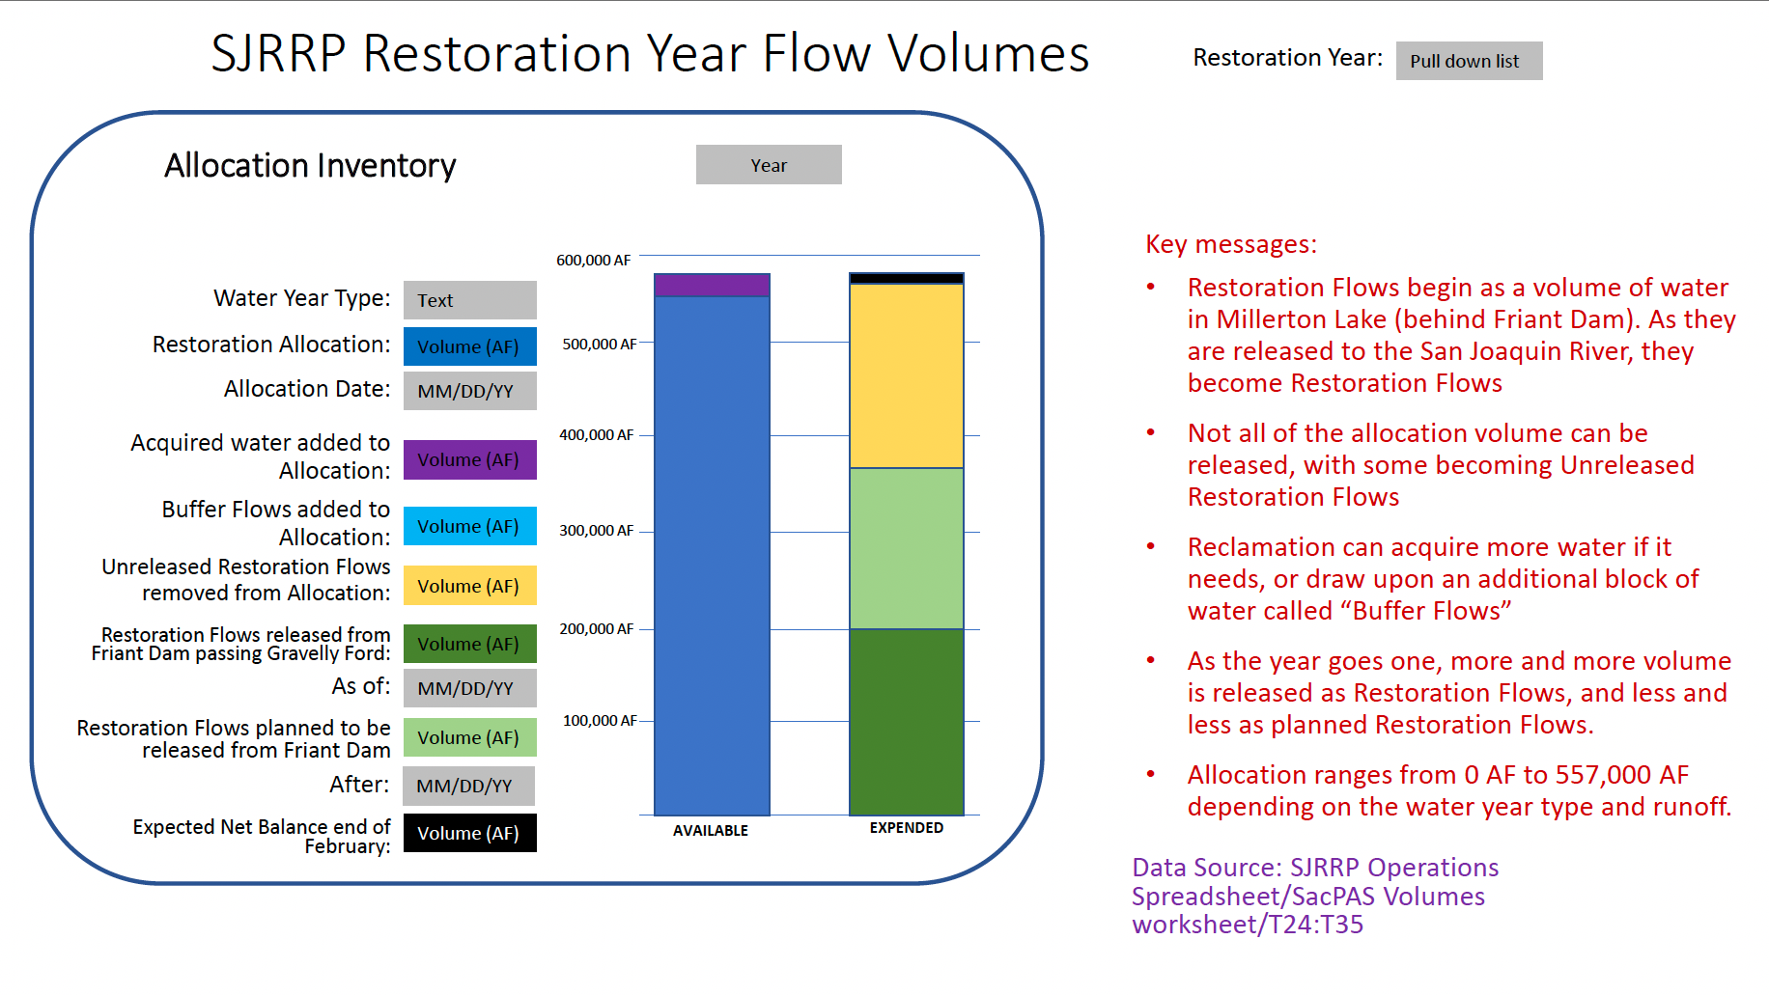
Request included prototype & context

Slide 7
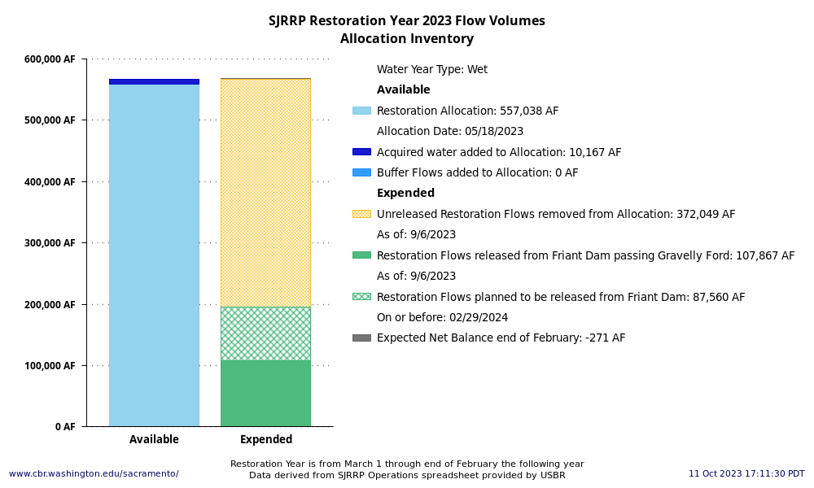
SacPAS recreates prototype with data

Slide 8
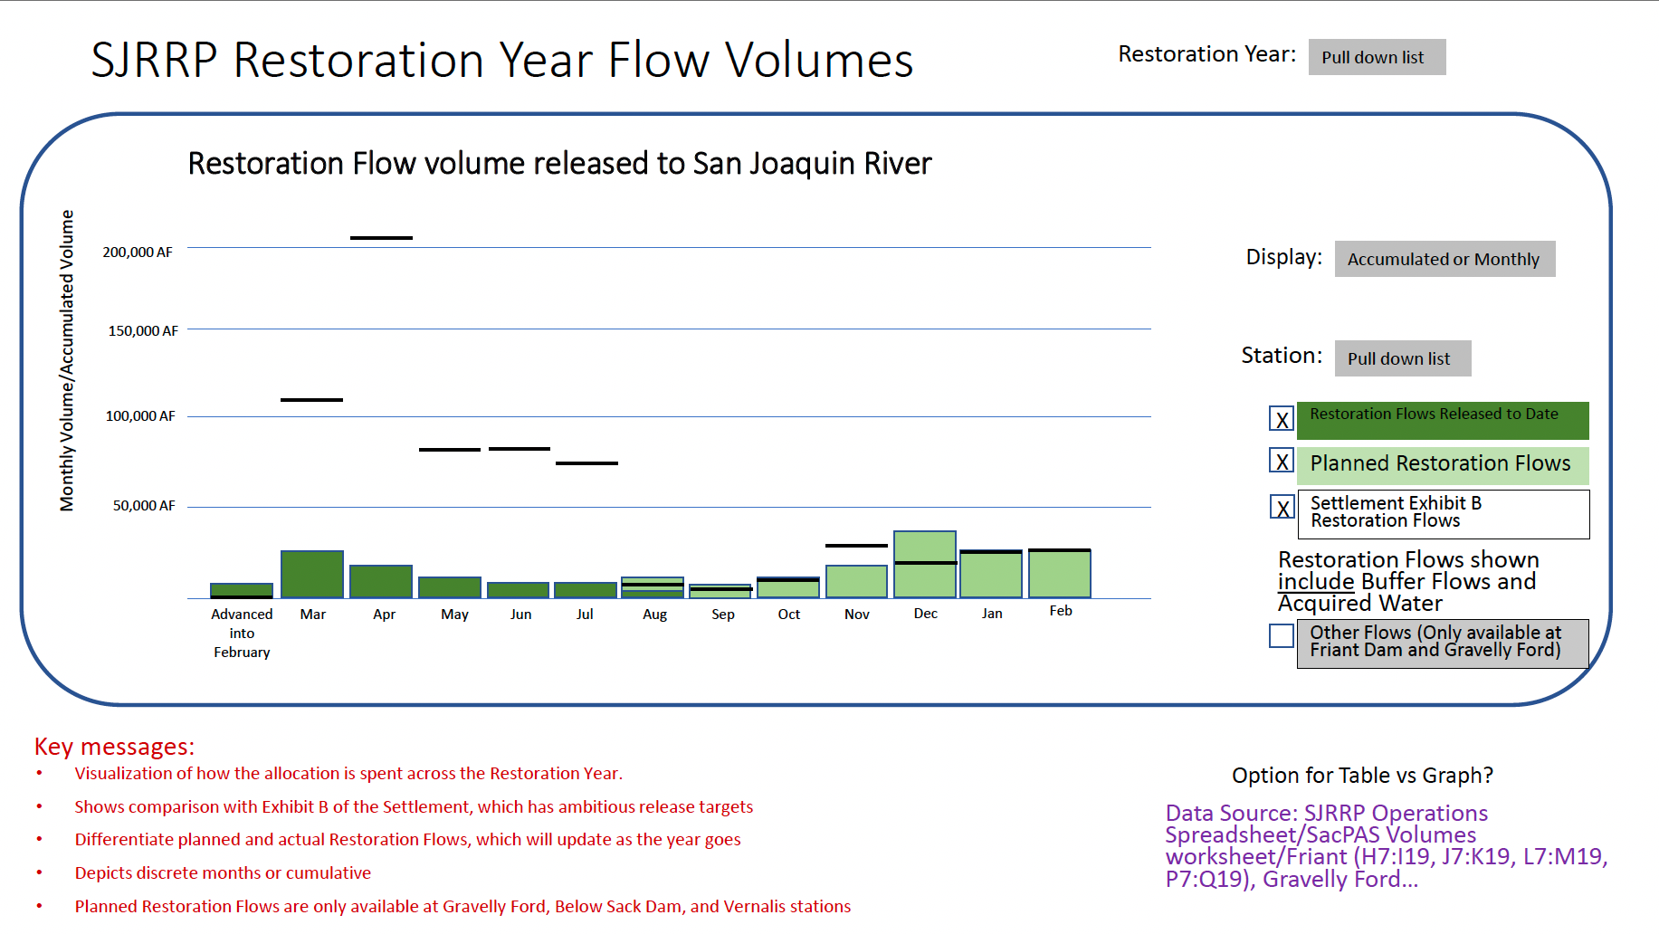
Another example of prototype in request

Slide 9
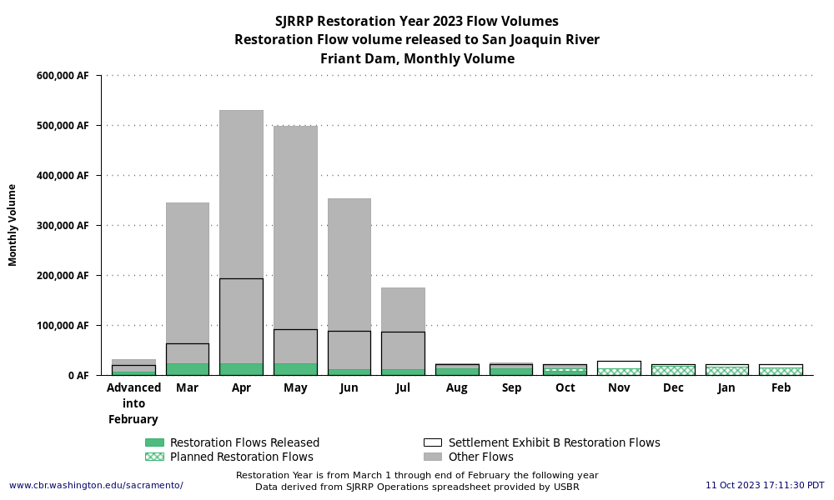
SacPAS recreates prototype with data

Slide 10
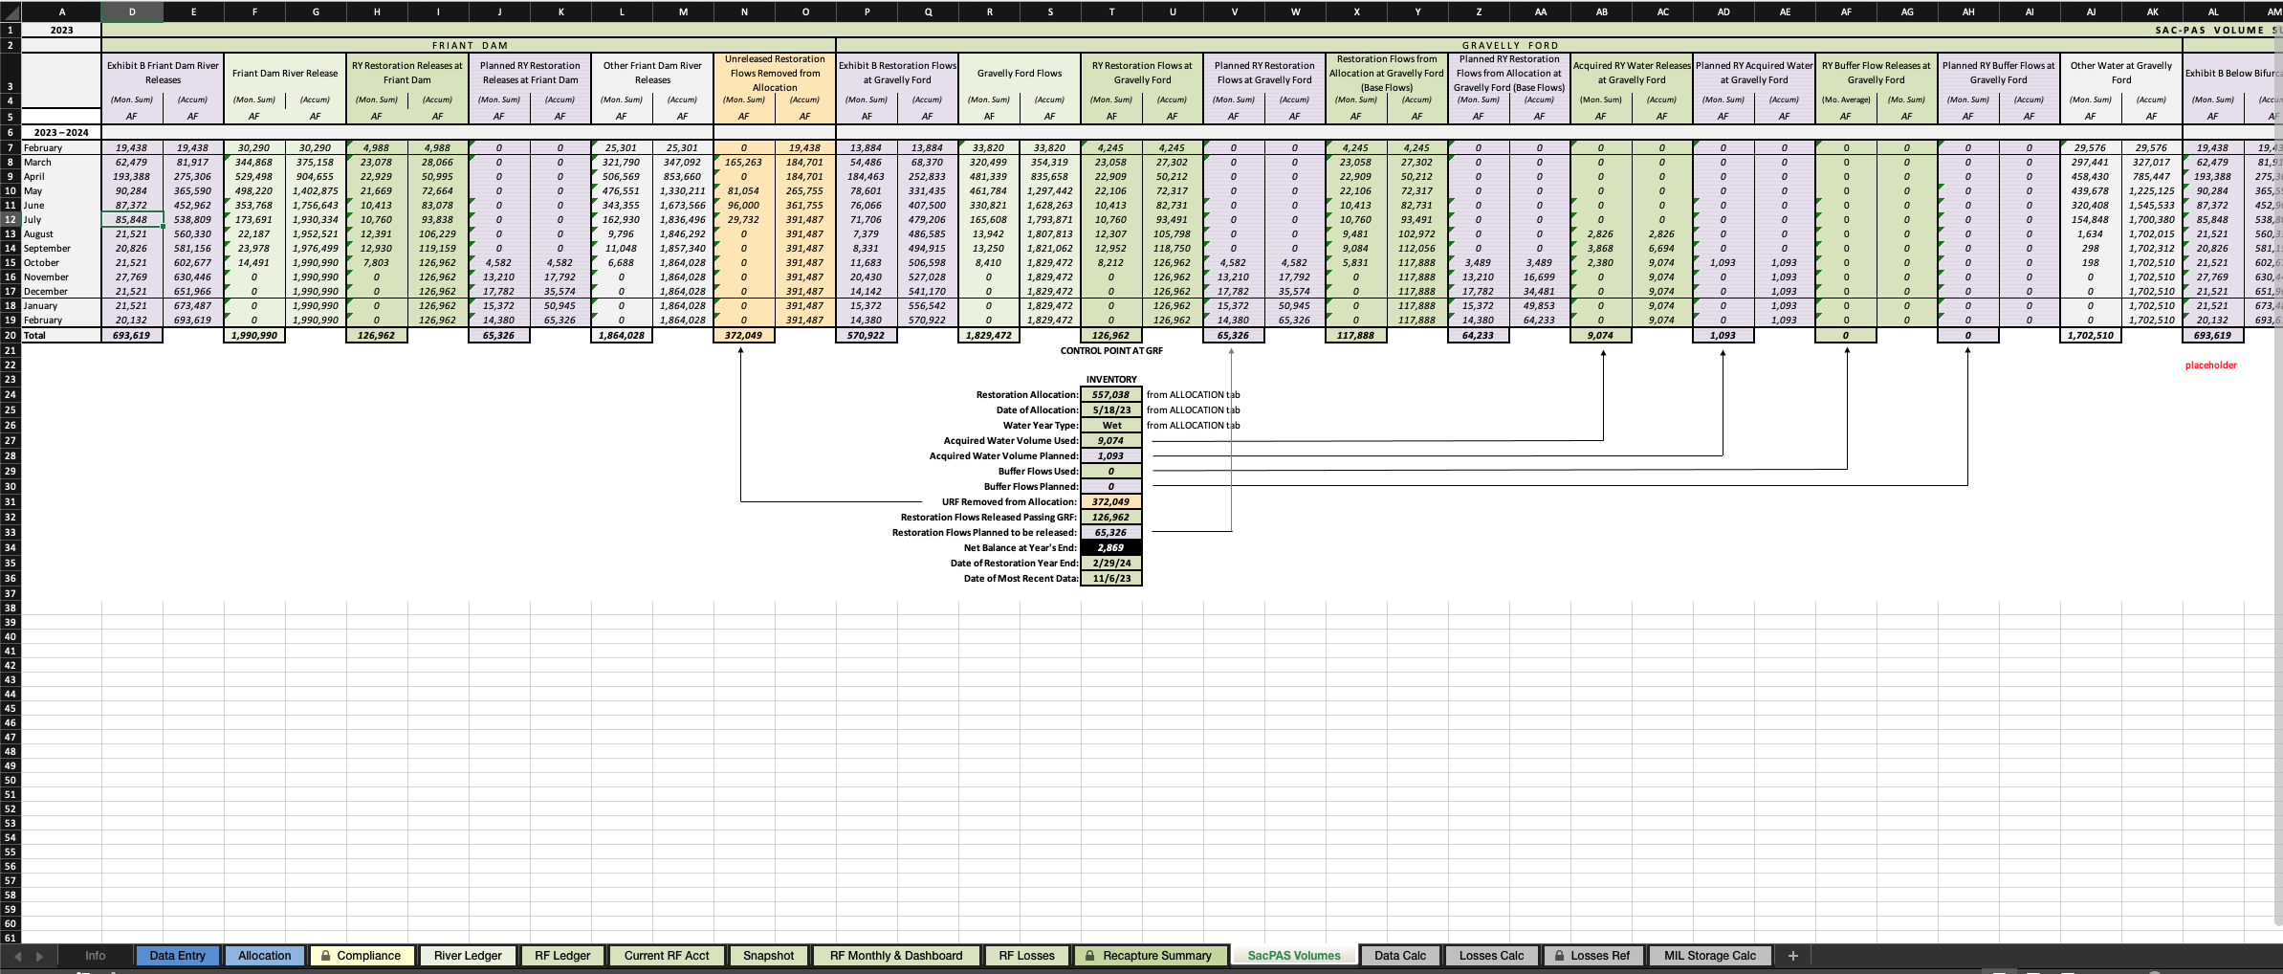
Data from spreadsheet downloaded from SJRRP website
Operations spreadsheet
SacPAS worksheet, introduced into a process that already exists
Notes:
~100 lines of code to monitor website for new file and retrieve it; ~350 lines of code to extract worksheet data and parse and format it for use
SacPAS builds process to extract data from worksheet and format for internal/back-end processes to support database, visualizations, data queries and reports

Slide 11
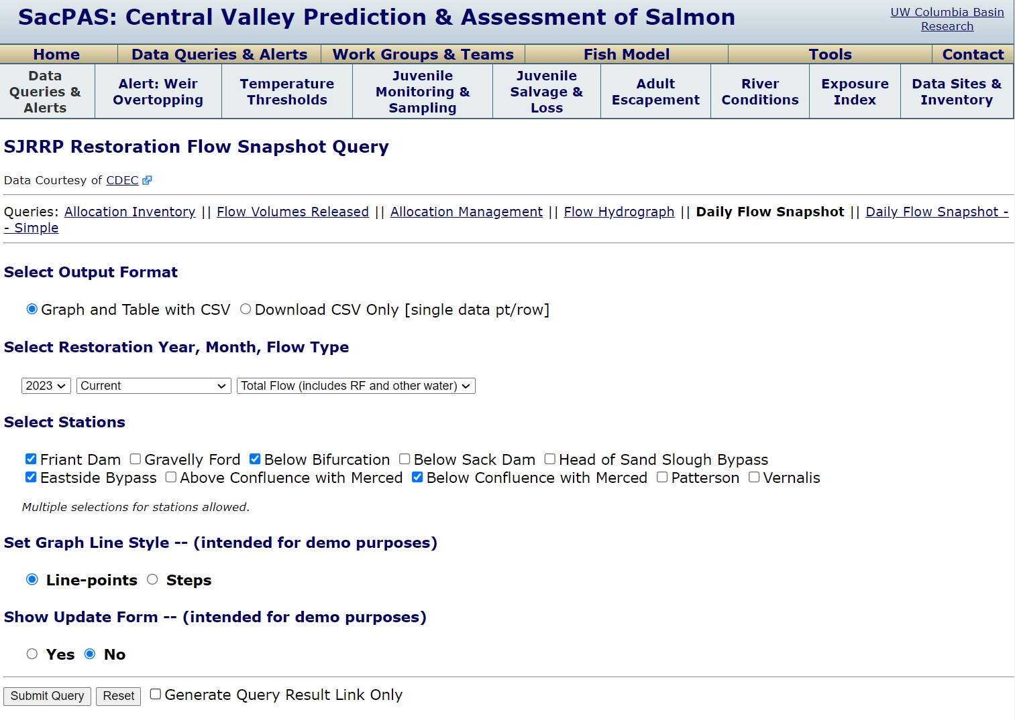
Initial prototyping on the web – Query interface and sample outputs

Slide 12
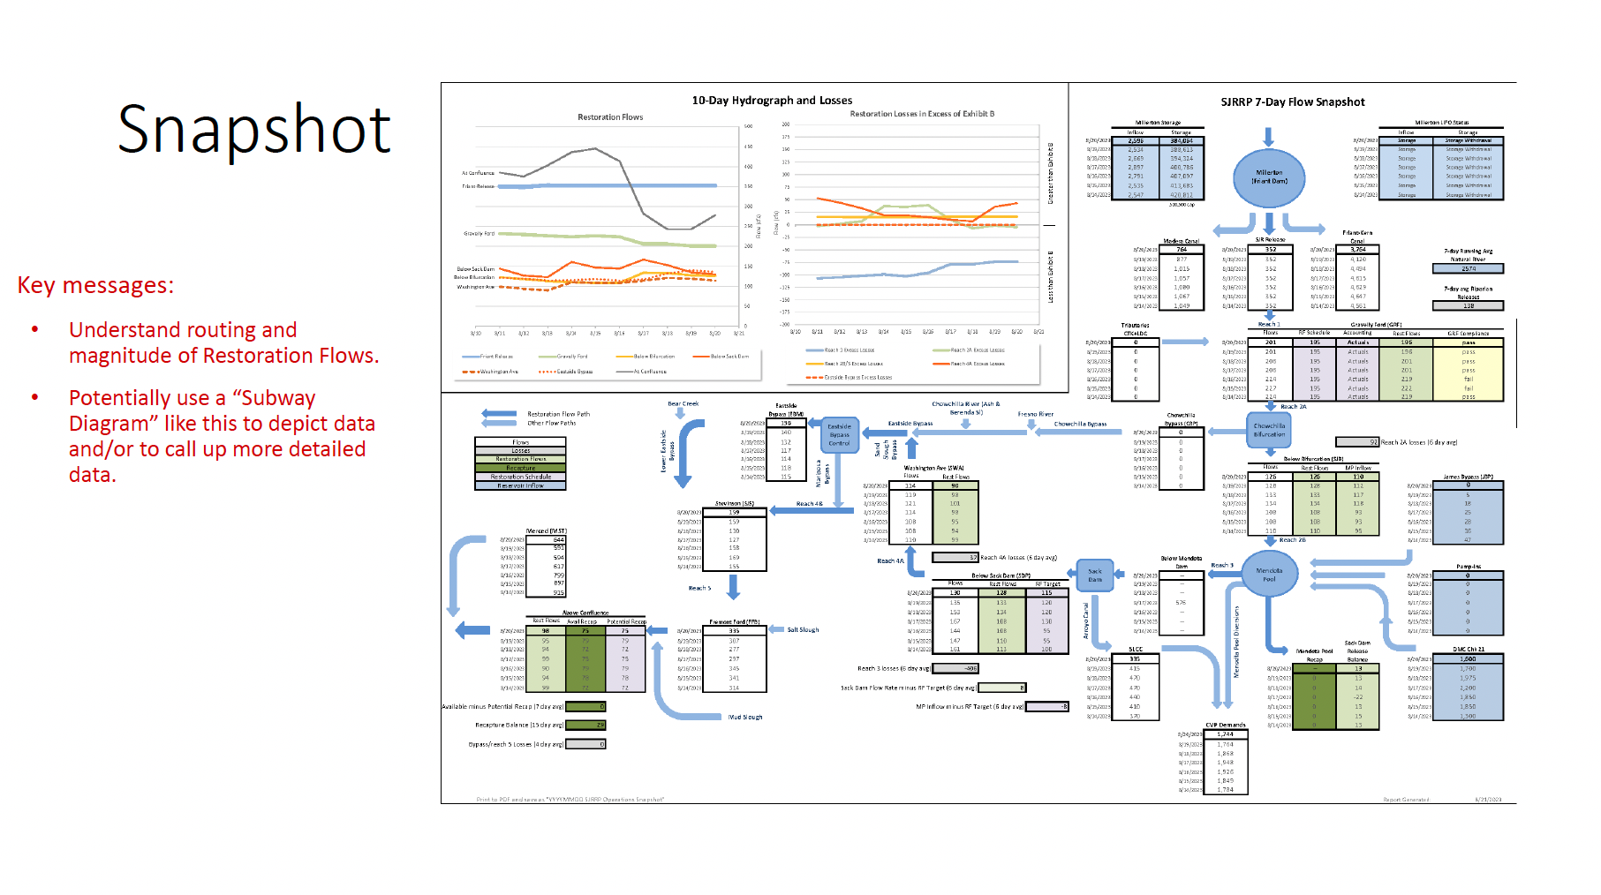
More products to come…

Slide 13
Design Thinking process of co-creating a SacPAS tool
Initial meeting
Understand needs & SacPAS capabilities
Given complexity of requests, monthly meetings to help keep the process going
Aim to meet needs of users
Accuracy of information
Improved workflow for data management and automation
Types of graphs
Colors (vision deficiency options)
User interface
Interaction design
Accessibility
508 compliance
Debugging
New ideas

Slide 14
Hearing from Chad and Erika about their experiences with SacPAS in this process thus far…
SacPAS is an established source of information for Delta and fisheries management. It made much more sense to build upon SacPAS than to build a separate data product.
The presentation of Restoration Flow data is critical to integrating SJRRP operations into Delta operations and protecting those flows.
The SacPAS team has a good understanding of CA water while also having the expertise to artfully present the data. We think this combination is essential to this project.
We immediately found a good synergy working with the SacPAS team

