Slide 1

Recap and Closing
December 6, 2023
Sacramento CA & Online

Slide 2
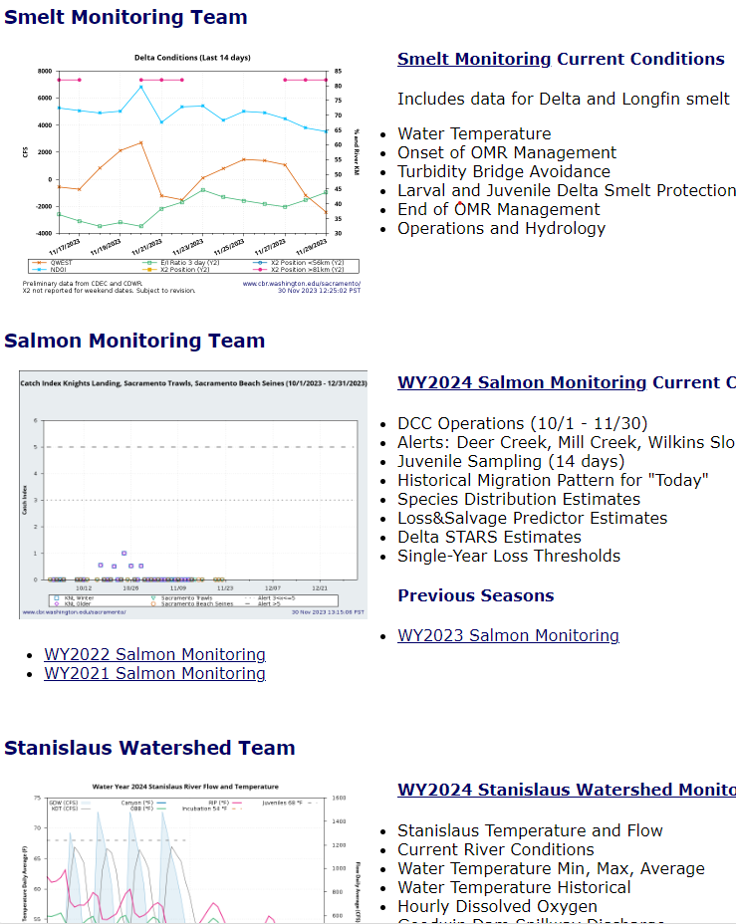
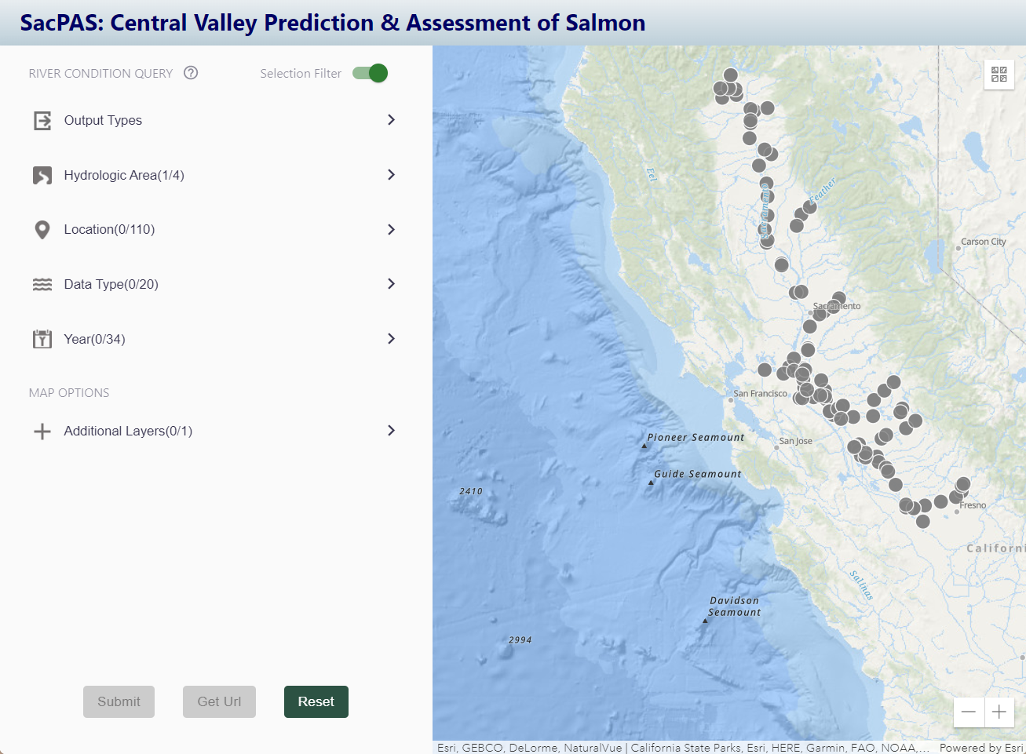
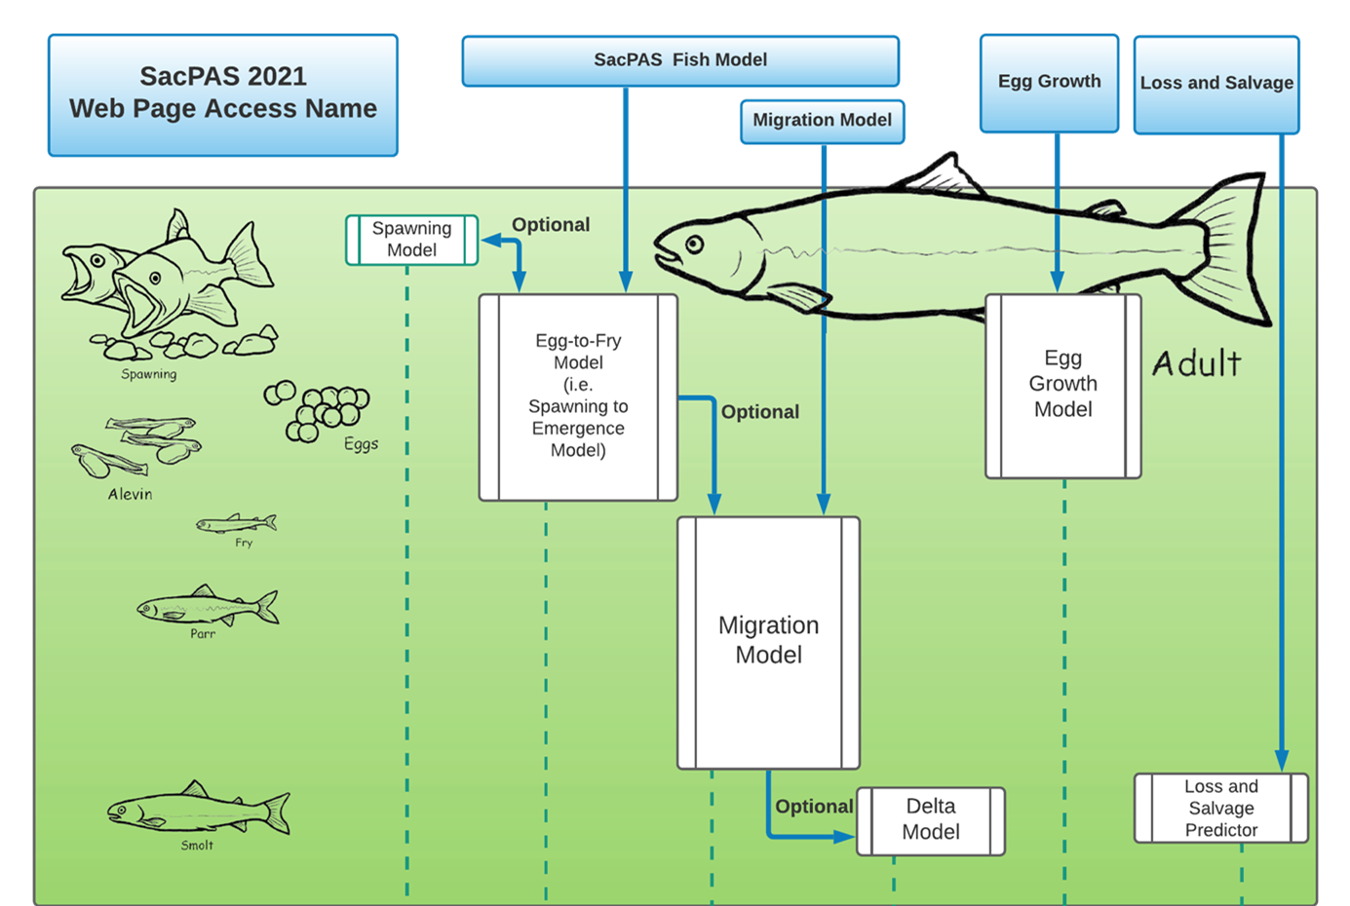
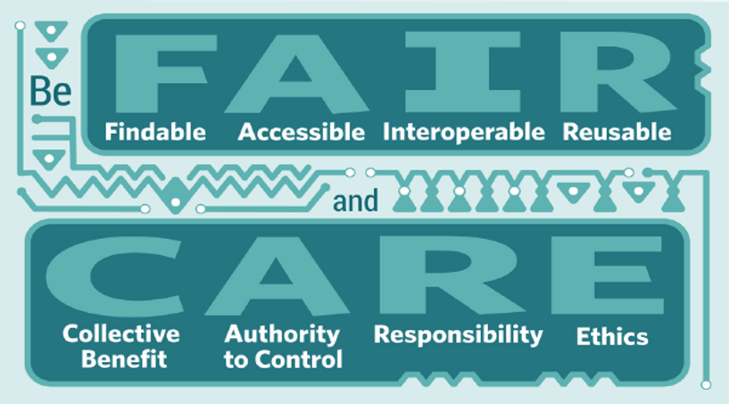
Recap
Goals for collaboration
History and philosophy of CBR team and SacPAS/CVPAS
Tour of the website and tools
Fish and environmental queries
Team pages
Modeling tools
Review of open data principles and database management examples
STARS
STARS Model
Notes:
Thank you all again for participating in today’s workshop. We really appreciate your taking the time to learn about SacPAS and to provide feedback for improving the site.
To recap our day today, we started today with an overview of our goals for the workshop and our aim to provide a collaborative space for all users
We shared the history and philosophy of the CBR team and SacPAS
We then took a tour of the website and tools, including fish and environmental queries, team pages and modeling tools
We then reviewed open data principles and database management examples
Lastly, we had some open discussion time and will follow up with suggestions from today.

Slide 3

Next steps
Follow-up with those with suggestions and those whose questions are not answered today. Fill out an inquiry if desired.
Meeting materials available at: www.cbr.washington.edu/sacramento/SacPAS2023workshop/ (will email out the link)
Contact:
Jennifer Gosselin, PI of SacPAS Gosselin@uw.edu
Catarina Pien, Reclamation contact cpien@usbr.gov
https://www.cbr.washington.edu/

Slide 4

SacPAS Workshop Office Hours
1:30 - 3:30pm
Continue open discussion
Breakout groups
https://www.skillshare.com/
Notes:
As a reminder, office hours will start at 1:30 for those of you who would like to further delve into tools or brainstorm ideas. This will be open to both remote and in person participants. I will insert a poll to get an idea of who is coming and what they are interested in, so we can figure out how best to form groups for the afternoon. If you are planning to attend, please fill that out now. Also feel free to put in the chat more specifics about what you would like to discuss in office hours.

